Slide 1
Boat bumper Challenge
Tampa Deep Sea X-Plorers Team Red Solution
Art Ianuzzi
Dexter Bautista
David Meiller

Slide 2
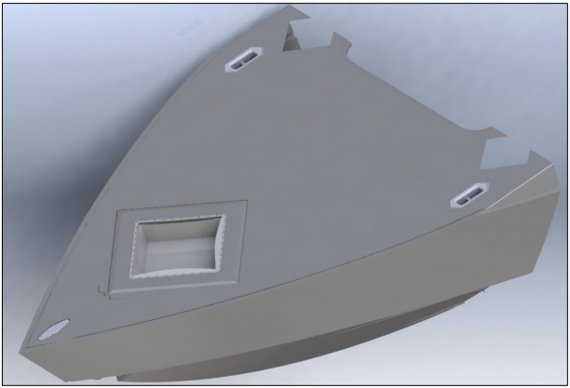
objectives
Design a removeable boat bumper that:
Allows for the safe transfer of personnel
Protect the bow from impacting target vessels
Is not permanently attached to the bow
Can be attached by one person in 5 minutes in 4-6’ seas
Fits in a 4x4x2 foot hatch area
Attaches to existing tie-down locations
Can withstand 5,000 lb static and 1,000 lb, 1Hz dynamic loads

Slide 3
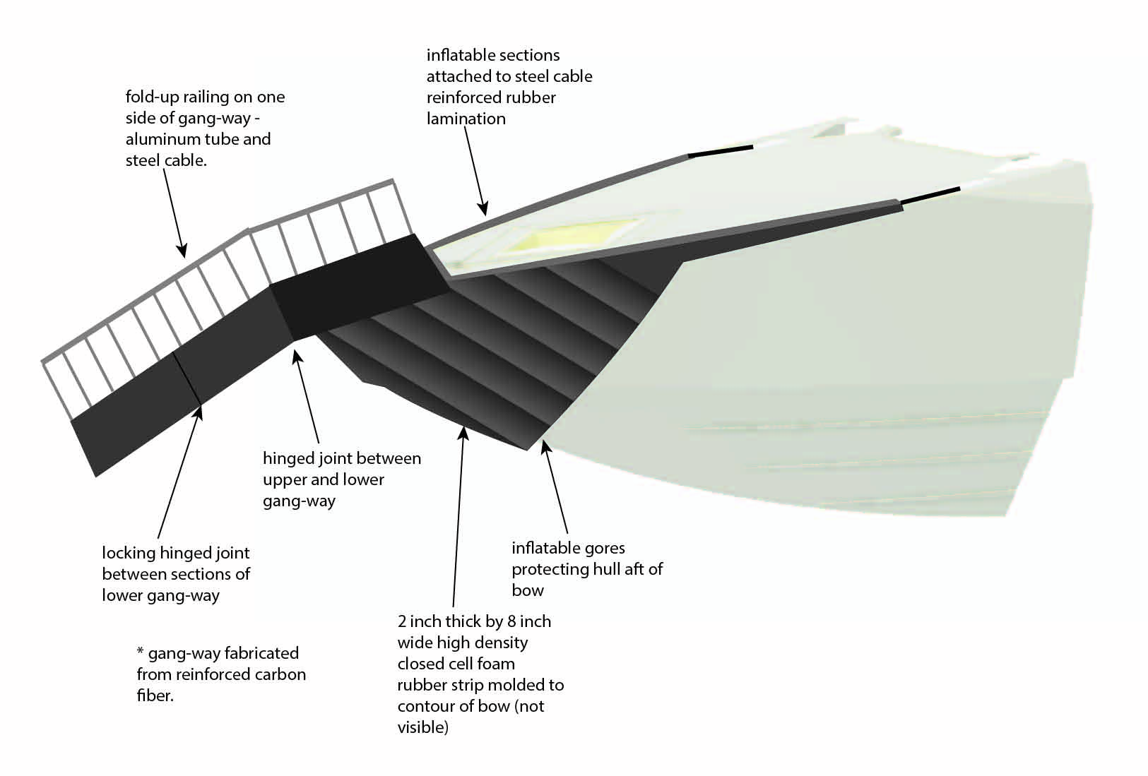
Solution

Slide 4
Solution
Safe transfer of personnel:
Reinforced carbon fiber gang-way
Three sections, folding with hinges
Top section secured to the rest of the device
Lower two sections are free to swing up and down to accommodate height of target vessel
Lower two sections are hinged so that load maintains the flat plane of the lower portion and also have a locking mechanism
Fold up hand rail of aluminum tubing and steel cable on one side of gang-way to steady personnel while still providing mobility if they are carrying bulky equipment

Slide 5
Solution
Protection of the bow :
The bow-bumper of the device will consist of three parts
High density closed-cell foam rubber strip over bow, approximately two inches thick and eight inches wide
A set of inflatable gores composed of 1/8” rubber laminated with Kevlar for durability
A rubber/Kevlar and steel cable lay-up that extends back from the inflatable portion that secures to existing attachment points
All edges of the device will contain embedded steel cable for structure and to control elasticity
Lower edge lines of inflatable portion will be geodesics so that the device will remain firmly affixed to bow by tension alone – preventing personnel from the need to hang over the bow to attach the front of the device
Device will be inflated using existing 80 cf air tanks

Slide 6
Solution
Attachment and Storage:
The device will be attached by unfolding it from its stored configuration and loosely attaching the straps to the two existing tie-down locations.
The gang-way section will be places near the bow and the remainder of the device will be thrown over the bow and sides.
The device will then be positioned and inflated, locking it in to position.
Finally the gang-way will be unfolded and locked and the hand rail will be unfolded and secured. This portion of the process can be delayed until the vessel is against the target vessel.
With the gang-way folded and the remainder of the device rolled up it will easily fit within the allotted storage space.

